Slide 1
Brussels United FC
‘Overall’ column is the key column identified in the analysis.
This gives the value of each player on a scale of 0 to 100
I use this to find the best players from the dataset
Here another challenge is the restriction to a budget
The team should also select players who can play for different positions or in multiple positions
Also the contract expiration of the player is necessary to consider him in the selection process

Slide 2
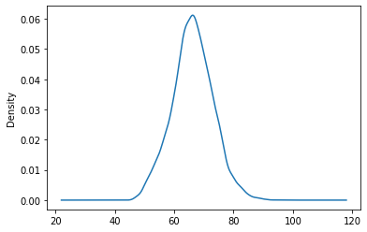
The below plot shows that most of the Overall rating of the players lies in the range of 60-70.
It is good to choose players above this range so that the chance of winning is high
This table shows us the distribution of the overall value of all the players in the dataset.
This gives us the insight of the players

Slide 3
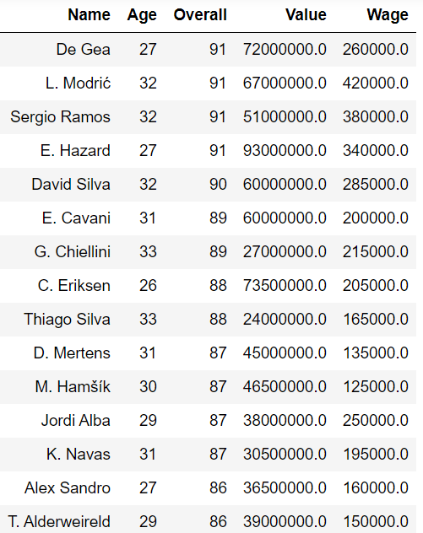
This table shows us the list of top 15 players with highest overall
These players are available from 2020 as their contract ends then
I recommend to have 2-3 members from this list to improve the performance of Brussels FC

Slide 4
INSIGHTS:
As the budget was not mentioned , I cannot come to the combination of players at this point
Leaving it aside to the club, I here recommend the top 5 players at each position with their wage and overall
The above data can be found in the python file
From the analysis I did not find any top player who could play in multiple positions
Also there are more number of positions than the number of players required, again the choice of positions are left to the FC itself.

Slide 5
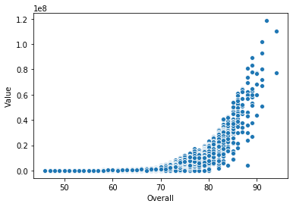
1. From this image It is clear that the
value of players increases hugely
above an Overall of 80
2. choosing players between 75 and 85
can save a lot on the investment on
the team
3. So, all the above factors should be kept in mind when choosing a team and the best optimal solution should be recommended to the FC
Thanks – Ganesh Ram M

